Slide 1




EasyPG PG MANAGEMENT SYSTEM
Stay Smart. Manage Smarter.

Slide 2


TABLE OF CONTENTS
01
02
03
04
Introduction
UML Diagrams
Database
Design
UI
Design

Slide 3


Why This Project? (The Problem)
Difficulty for outstation students to book PG rooms remotely.
No formal rent payment tracking or reminders.
No structured complaint/maintenance resolution process.
PG owners struggle with Excel-based record keeping and tenant management.
Lack of visibility and online reach for PGs.

Slide 4
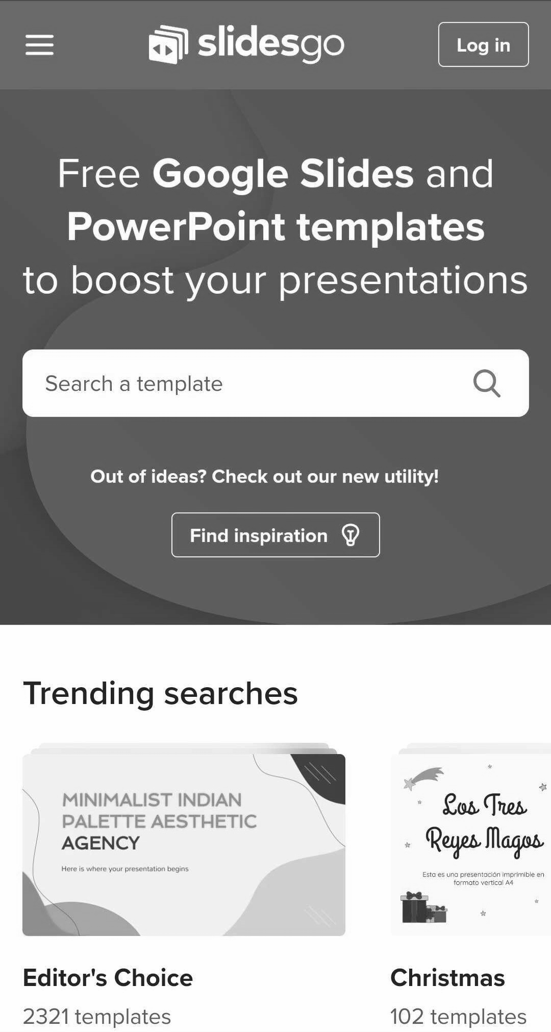
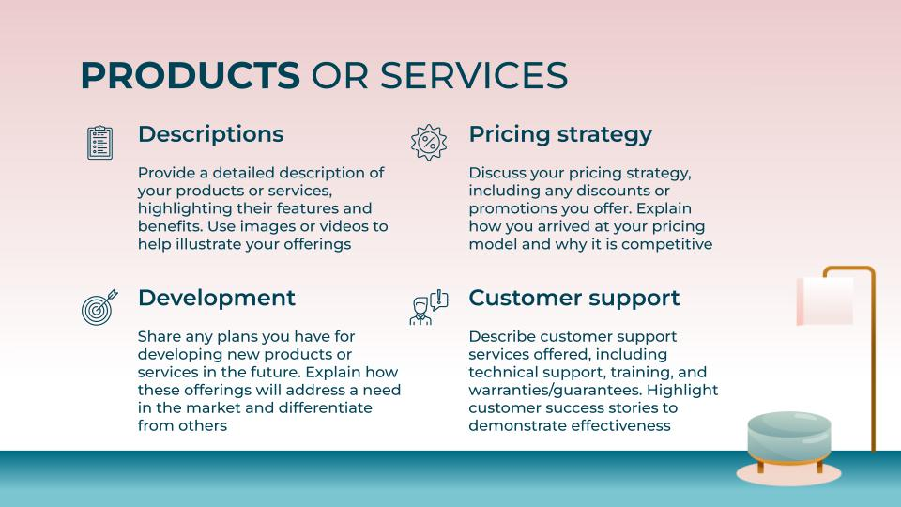


What We’re Building (The Solution)
Centralized platform for:
Guest room search and registration.
Tenants to book rooms, pay rent, raise and track complaints.
Admins to manage rooms, bookings, complaints, and rules.
Techstack for the project:
Frontend: React.js – clean UI, responsive design.
Backend: Spring Boot – RESTful APIs and business logic.
Database: MySQL – structured and relational data storage.

Slide 5
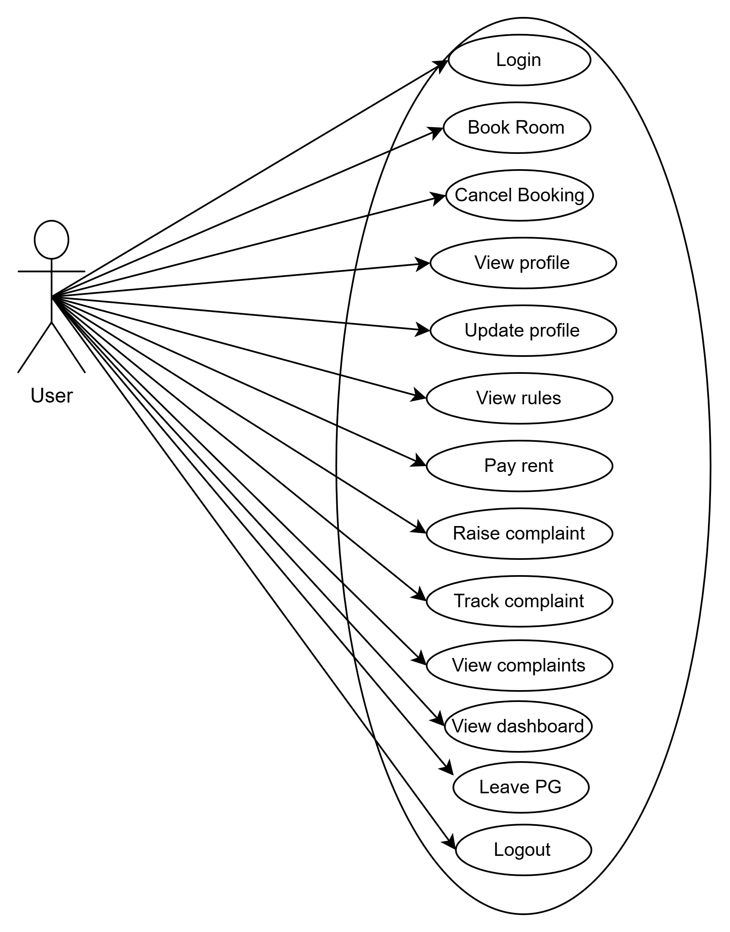
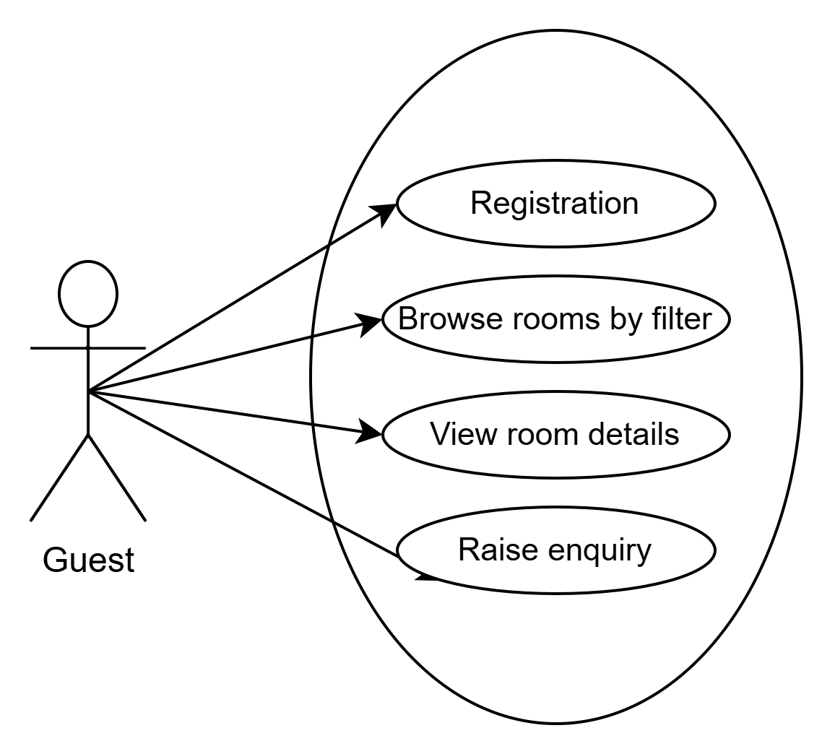
UML Diagram

Slide 6
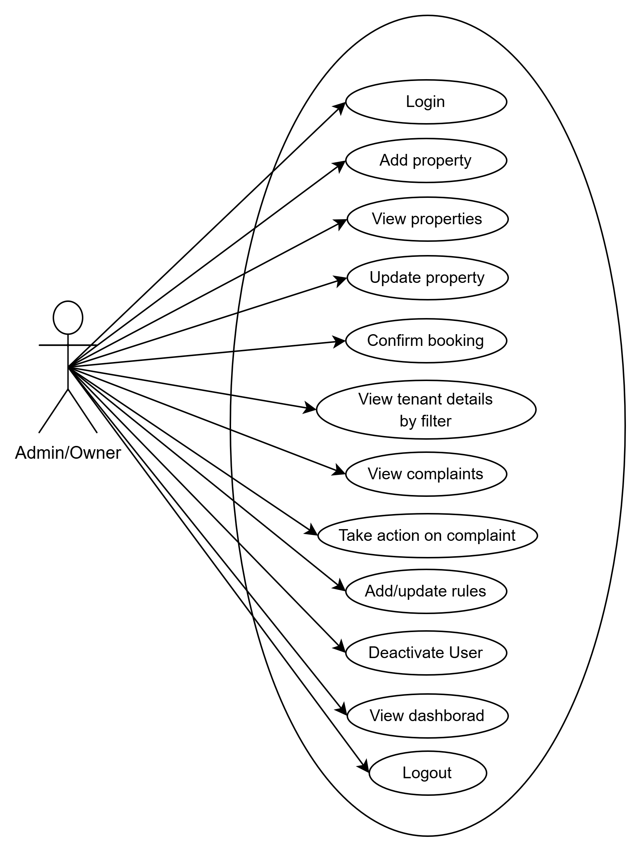

Slide 7
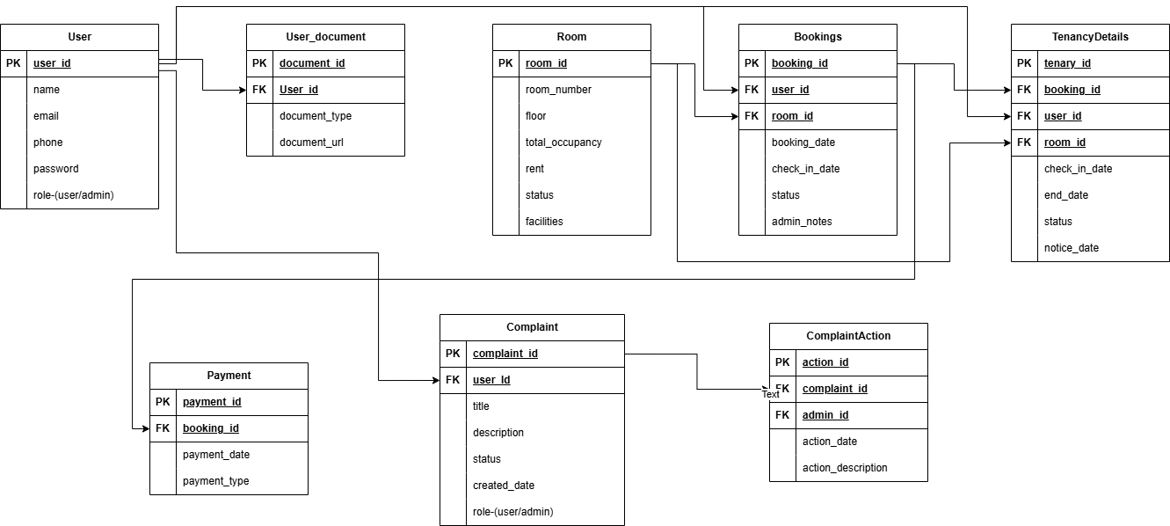
ER Diagram

Slide 8


THANKS!

Slide 9
MARKETING & SALES STRATEGY
Target market
Value proposition
Mk channels
Identify your target audience, including demographics, psychographics, and potential buyer personas
Clearly communicate the unique value that your product or service provides to customers compared to that of your competitors
Outline the channels you will use to reach your target market, such as social media, email marketing, among others
Sales process
Competitive analysis
Metric and goals
Describe how you plan to convert leads into customers through your sales process
Analyze the strengths and weaknesses of your competitors in terms of their products/services, pricing strategy…
Define key performance indicators (kpis) that measure the success of your marketing and sales efforts. Set specific goals

Slide 10

$4,498,300,000
Budget for the new products/services of the company

Slide 11
REVENUE INFORMATION
 | Q1 | Q2 | Q3 | Q4 | Total
Product sales | $50,000 | $60,000 | $75,000 | $90,000 | $275,000
Labor | $20,000 | $24,000 | $30,000 | $36,000 | $110,000
Salaries | $15,000 | $18,000 | $20,000 | $24,000 | $77,000
Marketing | $7,000 | $8,000 | $9,000 | $10,000 | $34,000
Net income | $24,500 | $26,750 | $28,000 | $34,250 | $113,500
Rent | $5,000 | $5,000 | $5,000 | $5,000 | $20,000
Utilities | $1,500 | $1,750 | $2,000 | $2,250 | $7,500

